Slide 1

Real-Time Flood Resilience with Cloud Tech
Protecting cities, empowering communities. The future of flood management is here.

Slide 2
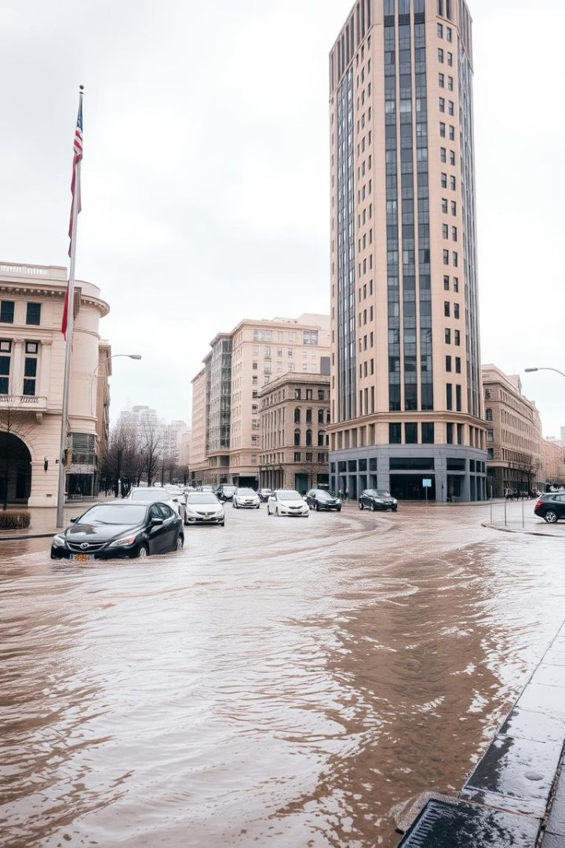
Urban Flooding: A Growing Crisis
Economic Impact
$40 billion damage yearly in US cities (NOAA)
Rising Incidence
78% increase in urban floods since 2000 (US EPA)
Root Causes
Aging infrastructure
Climate change
Rapid urbanization
Severe Impacts
Economic losses
Displacement
Health risks

Slide 3
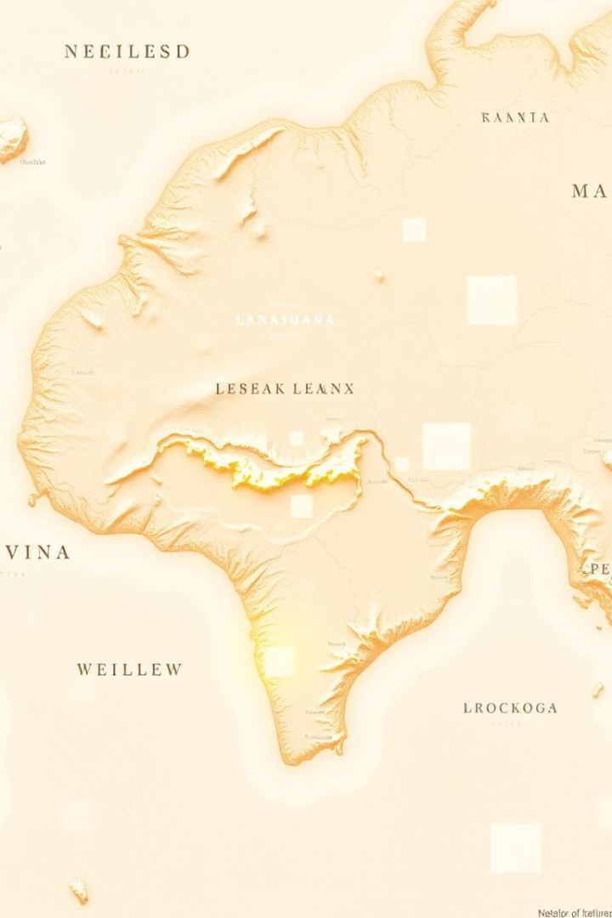
Cloud-Optimized GeoTIFFs (COGs): Revolutionizing Flood Mapping
What are COGs?
Geospatial data for efficient cloud access and use
Key Benefits
Faster processing, lower storage costs, high scalability
Standard Format
Supports interoperability across platforms and tools
Performance
Processes data 10x faster than traditional methods

Slide 4
Real-Time Flood Resilience: A Cloud-Based Workflow
Data Integration
Cloud Processing
Real-Time Dashboards
Emergency Integration
Satellites: Landsat, Sentinel
AWS, Google Cloud, Azure
Interactive visualizations
Seamless connection with response systems
Sensors & IoT devices
Scalable computing power
Instant flood insights

Slide 5
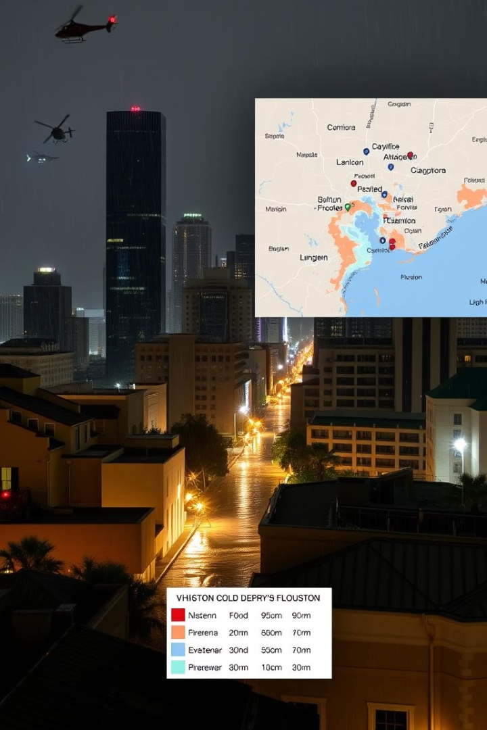
Case Study: Houston's COG Flood Mapping System (2023)
92.7%
Overall Accuracy
0.89
Kappa Coefficient
0.91+
F1-scores
For all flood severity classes
Proactive
Resource Allocation
Enable proactive deployment of resources

Slide 6
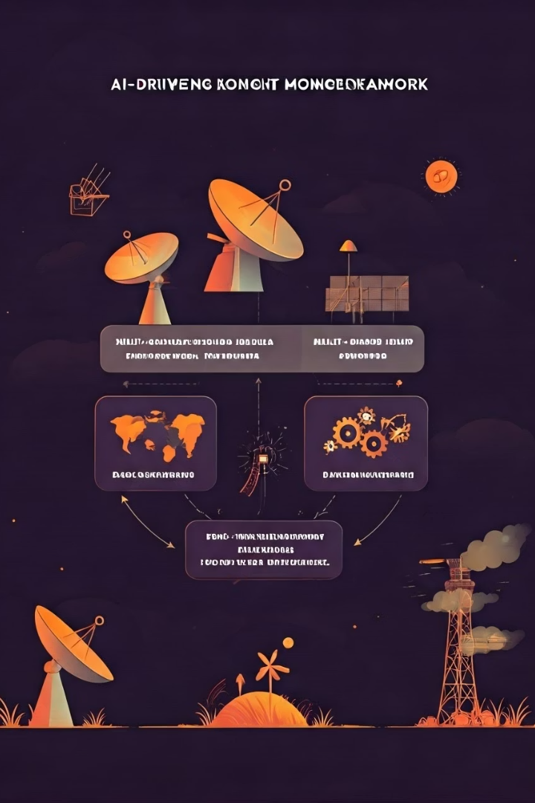



AI-Driven Drought Monitoring Framework
4 SOTA Models
EfficientNetB3, YOLOv11n (spatial localization), MobileNetV3, ViT (long-range dependencies)
Multi-Source Data
Satellite imagery combined with NDVI/VCI indices for enhanced accuracy
Real-Time Deployment
Optimized for real-time field monitoring and rapid decision making

Slide 7

Real-Time Flood Resilience Summary
Understand Risks
Recognize urban flooding threats and impacts
Adopt Technologies
Use COGs, cloud computing, and AI for resilience
Take Action
Partner with experts to protect your city

Slide 8
Why Cities Must Act Now
Speed
Cost
Scale
Minutes, not hours, to map floods
50% lower cloud-processing costs
Works for megacities to towns
Floods cost $40B/year—COGs cut losses.

Slide 9
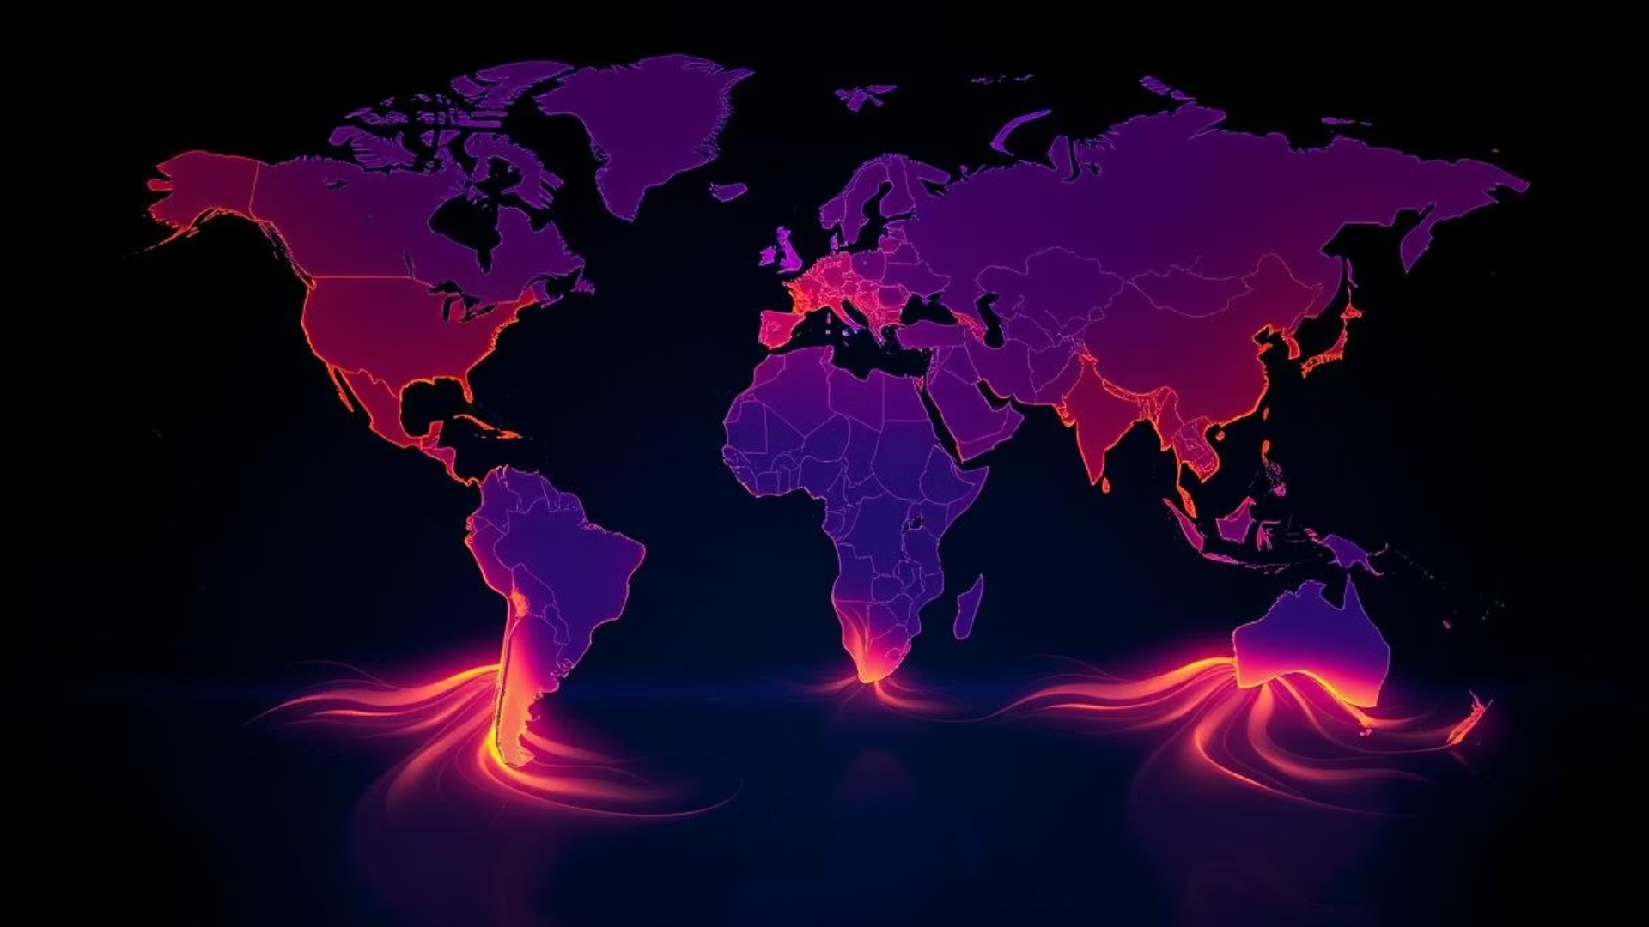
Start Building Resilience Today
Adopt COGs. Save Lives. Save Costs.
[ Pilot a free cloud-mapping trial ]

